Slide 1




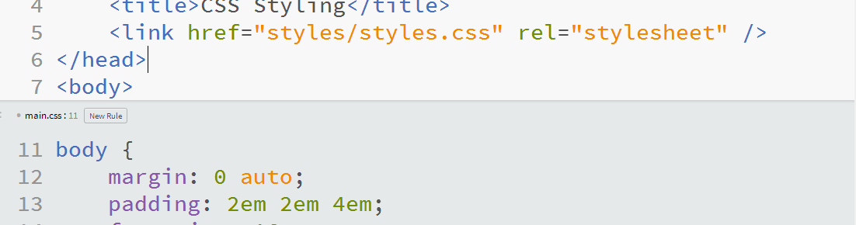
Web Fundamentals (HTML and CSS)
Course Introduction
SoftUni Team
Technical Trainers
Software University
http://softuni.bg

Slide 2







SoftUni Diamond Partners

Slide 3


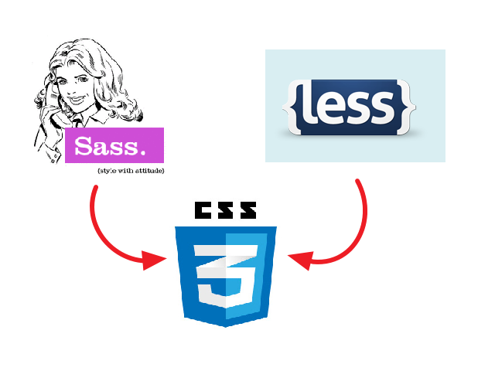

Table of Contents
Course Objectives
Course Program
Trainers Team
Examination
Learning Resources

Slide 4
Level #1 at the Software University
Java Basics
6 times + TW + labs + exam
4 weeks * 2 times
Web Fundamentals (HTML + CSS)
10 times + TW + labs + exam
4 weeks * 3 times
JavaScript Basics
6 times + TW + labs + exam
4 weeks * 2 times
PHP Basics
6 times + TW + labs + exam
4 weeks * 2 times
Teamwork and Personal Skills
4 times
16 weeks * 1 times
Teamwork and Personal Skills (Part II)
6 times

Slide 5

Web Fundamentals (HTML + CSS)
Course Objectives & Program

Slide 6


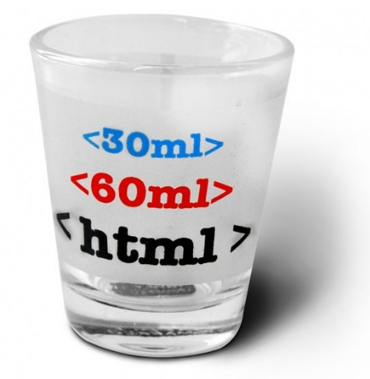
Web Fundamentals – Course Topics
Web Technologies Basics. Web Development Tools
HTML Fundamentals
CSS Overview
HTML Tables
HTML Forms
Semantic HTML, Frames, Other Tags

Slide 7
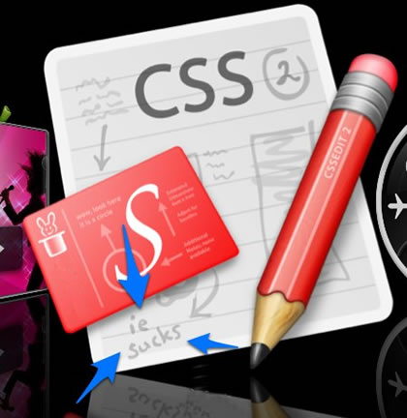

Web Fundamentals – Course Topics (2)
CSS Presentation
CSS Layout
Responsive Design
Advanced CSS: CSS Preprocessors, Bootstrap, CSS Transitions
Team Work
Practical Exam

Slide 8

The Trainers Team

Slide 9

Trainers Team
Nikolay Bankin
Top performing student from the Software University (2014)
Software Engineer at Obecto

Slide 10

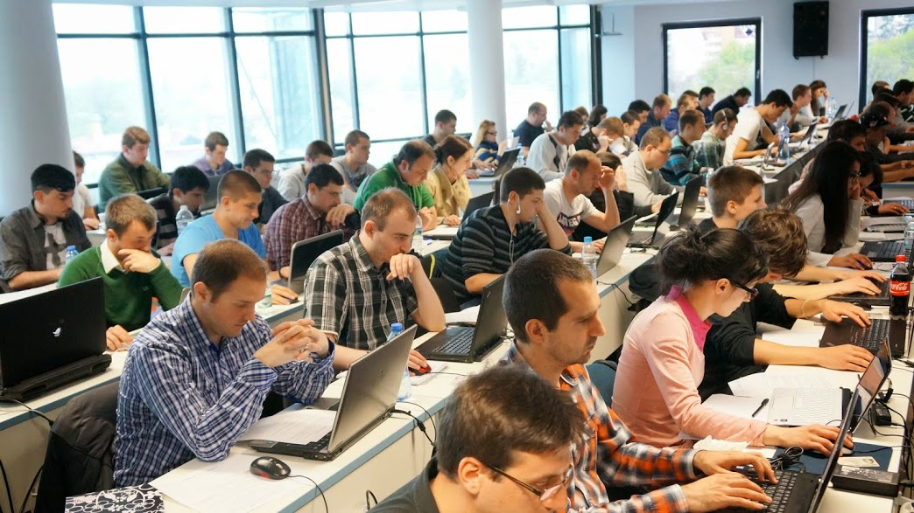
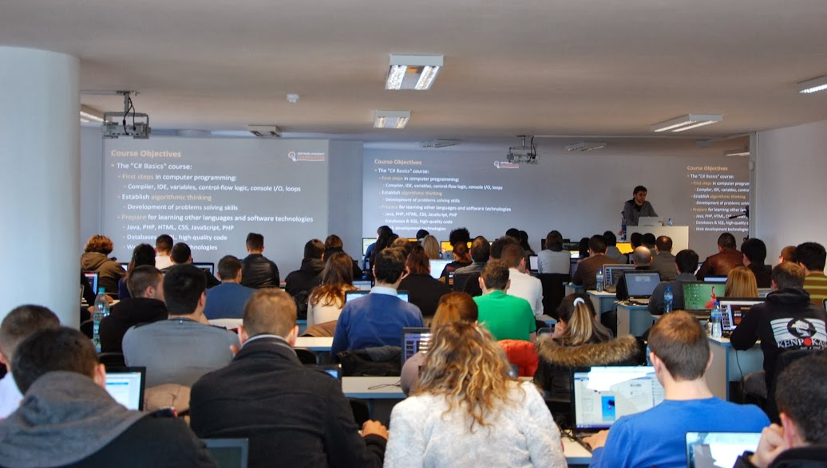
Volunteer Teaching Assistants
15+ volunteer teaching assistants
Developers from the software industry
Scholarship students from SoftUni

Slide 11

Web Fundamentals: More Details
Duration, Languages, Technologies

Slide 12


Training Duration – Web Fundamentals
Lectures: ~ 25 hours (onsite + YouTube videos)
Practical exercises (in class): ~ 15 hours
Homework: ~ 30-50 hours
Team project: ~ 10-20 hours
Exam preparation: 8 hours
Exam: 6 hours
Schedule: Feb – Mar 2015
Exam date: 8-Mar-2015

Slide 13
Why HTML & CSS?
HTML & CSS – standard for Web UI
Web-based application are very popular
Runs on any device with a Web browser
HTML5 is currently the #1 job trend based on the fastest growing keywords found in online job postings
HTML5 will get better and better and take bigger chunk of the mobile application market
Every IT professional should know HTML & CSS

Slide 14



Why English?
Why the slides are in English?
English is the native language of the software engineers
Specific terminology should be in English
Translations are inaccurate and funny
Just learn English!
No excuses

Slide 15



Web Fundamentals
Evaluation Criteria

Slide 16


Scoring System for the “Web Fundamentals”
Exam – 80%
Homework + evaluation – 5% + 5%
Team work: 10%
Bonuses: up to 10%
Presence in class
Assistant bonuses
Forum bonuses
Others

Slide 17
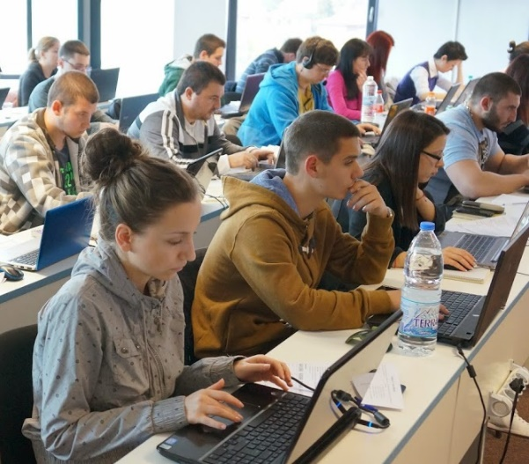
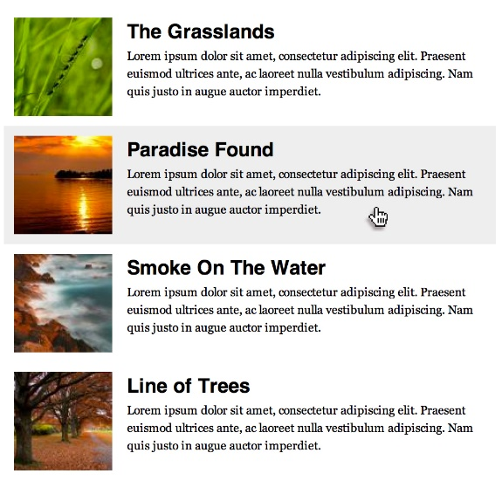



Web Fundamentals Exam
Practical HTML & CSS exam
You will be given a set of images
You should create the HTML & CSS
Sample exam problem:
+

Slide 18

Homework Assignments
Doing your homework is very important!
Programming can only be learned through a lot of practice!
You should write code every day!
Each lecture is followed by a few exercises
Try to solve them in class
The rest are your homework
Homework assignments are due in 2 weeks after each lecture
Submission will be accepted through our web site: softuni.bg

Slide 19

Homework Peer Reviews
Give feedback to a few random homework submissions
Students submit homework anonymously
Please exclude your name from the submissions!
For each homework submitted
Students evaluate 3 random homeworks
From the same topic, after the deadline
Give written feedback, at least 200 characters
Low-quality feedback → report for punishment
Everyone will get feedback for their homework

Slide 20









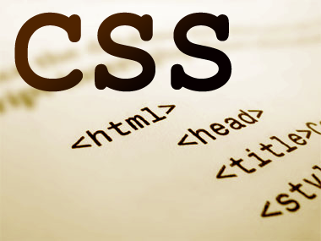
Resources
What We Need Additionally?

Slide 21

Course Web Site & Forums
The Web Fundamentals official web site:
Register for the "Software University Forum":
Discuss the course exercises with your colleagues
Find solutions for all course exercises
Share source code / discuss ideas / help each other
https://softuni.bg/courses/web-fundamentals/
https://softuni.bg/forum

Slide 22



Slides and Videos
All lecture slides, videos, homework assignments, projects and other resources are open content, available for free
Visit the course web site to access the course resources

Slide 23

HTML & CSS Tutorials
HTML & CSS @ Codecademy
http://www.codecademy.com/tracks/web
W3School HTML Tutorial
http://www.w3schools.com/html/
Learn to Code HTML & CSS
http://learn.shayhowe.com/html-css/
CSS Tricks
http://css-tricks.com

Slide 24
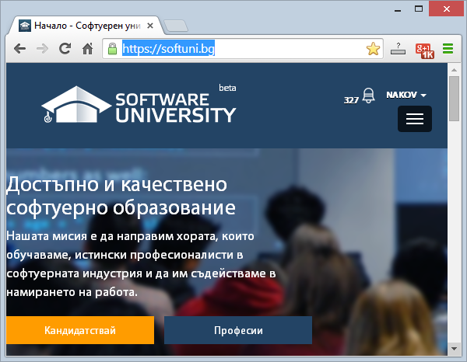
Software University Learning System (SULS)
Software University Learning System (SULS)
www.softuni.bg
Important resource for students
Homework submissions
Homework check-up
Exams and results
Reports about your progress
…

Slide 25


Recommended Software
You will need a text editor, e.g.
Notepad++
You may try many HTML authoring tools like:
Sublime Text
Brackets
Aptana Studio
Microsoft Visual Studio
Netbeans
Webstorm

Slide 26


Summary
The "Web Fundamentals" course teaches
The first steps in HTML & CSS
Training program
HTML, Tags, Tables, Forms, Semantic HTML, CSS, Styles, Positioning, Layout, Responsive
Practical exam
Form image to HTML & CSS + score system
Learning resources
Lectures, videos, software, books, forum
HTML & CSS

Slide 27
Web Fundamentals (HTML and CSS)
https://softuni.bg/courses/web-fundamentals/

Slide 28
License
This course (slides, examples, demos, videos, homework, etc.) is licensed under the "Creative Commons Attribution-NonCommercial-ShareAlike 4.0 International" license
Attribution: this work may contain portions from
"HTML Basics" course by Telerik Academy under CC-BY-NC-SA license
"CSS Styling" course by Telerik Academy under CC-BY-NC-SA license

Slide 29





Free Trainings @ Software University
Software University Foundation – softuni.org
Software University – High-Quality Education, Profession and Job for Software Developers
softuni.bg
Software University @ Facebook
facebook.com/SoftwareUniversity
Software University @ YouTube
youtube.com/SoftwareUniversity
Software University Forums – forum.softuni.bg

